Slide 1
Milliken Logistics Supplier Inbound routing guide
Americas Region
2023

Slide 2
Table of Contents
2
PAGE 2
Table of contents. . . . . . . . . . . . . . . . . . . . . . . . . . . . . . . . . . . . . . .
Purchase Order Routing Instructions Language . . . . . . . . . . . . . . . . . . . . . . .
3
FedEx Ground Instructions . . . . . . . . . . . . . . . . . . . . . . . . . . . . . . . . . . . . . . . .
4
FedEx Parcel Dimension & Packaging Limits . . . . . . . . . . . . . . . . . . . . . . . . . .
5
Milliken LTL Routing Guide . . . . . . . . . . . . . . . . . . . . . . . . . . . . . . . . . . . . . . .
6
LTL Bill of Lading Consolidation Instructions . . . . . . . . . . . . . . . . . . . . . . . . . .
7
Milliken Logistics Contacts . . . . . . . . . . . . . . . . . . . . . . . . . . . . . . . . . . . . . . ..
8

Slide 3
Vendor Routing Guidelines
3
In order to move its freight in the most efficient and cost-effective manner, Milliken & Company requests that all vendors and business partners route COLLECT or MILLIKEN 3RD PARTY PAID shipments according to the following guidelines:
COLLECT/EXW SHIPPING INSTRUCTIONS
For any shipment under 150 lbs. and/or that do not exceed 96 inches, please ship FedEx Ground – COLLECT
For any other parcel services, please contact parcelshipping@milliken.com
Any shipments over 96 inches and between 150 lbs. to 15000 lbs., please refer to the routing guide for carrier selection at http:// supplier.milliken.com
For any shipments over 15000 lbs. or exceeding 24 ft of trailer space, please contact Milliken Logistics for routing instructions:
. Angela Peterson: APeterson@Milliken.com
b. Laurie Ramsey: Laurie.Ramsey@Milliken.com
* Dimensional & Packaging limits apply – See pages 5-6 of this presentation or visit supplier.Milliken.com “Fedex Inbound Instructions”for
Fedex GROUND process. If the characteristics of the shipment (i.e., size, packaging, hazmat, etc.) make Fedex GROUND questionable, contact Milliken Logistics for instructions.
**
Milliken preferred LTLcarrier can be found on page 7 of this presentation or at supplier.Milliken.com under “Inbound Routing Guide Map”. See instructions for consolidating BLs (page 7 of this presentation).

Slide 4
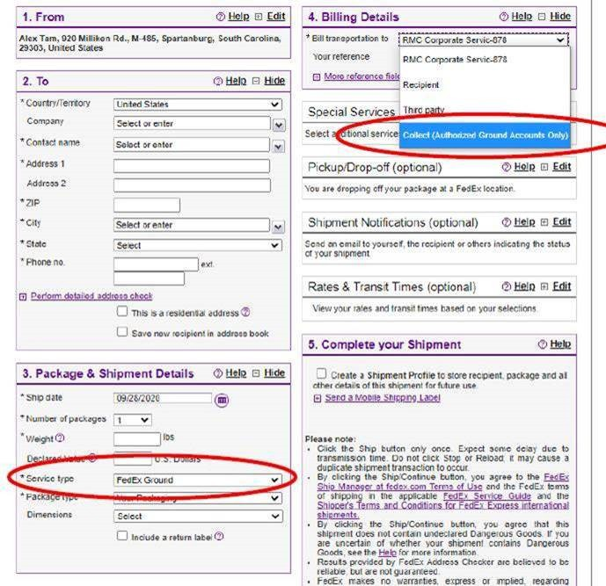
FedEx Ground Instructions
1
Enter the shipping Location's Address Details
Enter Correct Delivery location details, as provided by the Milliken Representative, or follow instruction on PO.
Enter the date material is ready for pickup, and provide accurate cargo details. Select Service type as ground unless otherwise instructed, select "your packaging type, and provide dimensions
When Selecting the service level, please select FedEx Ground Collect.
Add any additional special services only if requested, schedule the proper pickup/ drop off type, and click Complete shipment
IMPORTANT
Vendor should always select Fedex GROUND (i.e., not Next Day Air, Next Day Early AM, etc.) as the service type unless otherwise specifically instructed by the receiving Milliken location or an authorized Milliken associate.
See Dimension and Packaging Limits on Page 2

Slide 5
FedEx Parcel* Dimension & Packaging Limits
Please refer to the below service sensitive requirements below when determining how to ship your package:
FedEx Ground®:
Up to 150 lbs. per package,
Max length- 108” length
Max girth- 165” (L + 2H +2W)
FedEx Home Delivery®:
Residential shipments up to 150 lbs. per package
Max length- 108” length
Max girth- 165” (L + 2H +2W) FedEx Express®:
Up to 150 lbs. per package,
Max length- 96”
Max girth- 130” (L + 2H +2W)
* Length/Girth calculation = L + 2*W +2*H
•
* Parcel refers to all of FedEx's small package services (ground and air). It does not refer to FedEx Freight or other heavy-weight services.

Slide 6
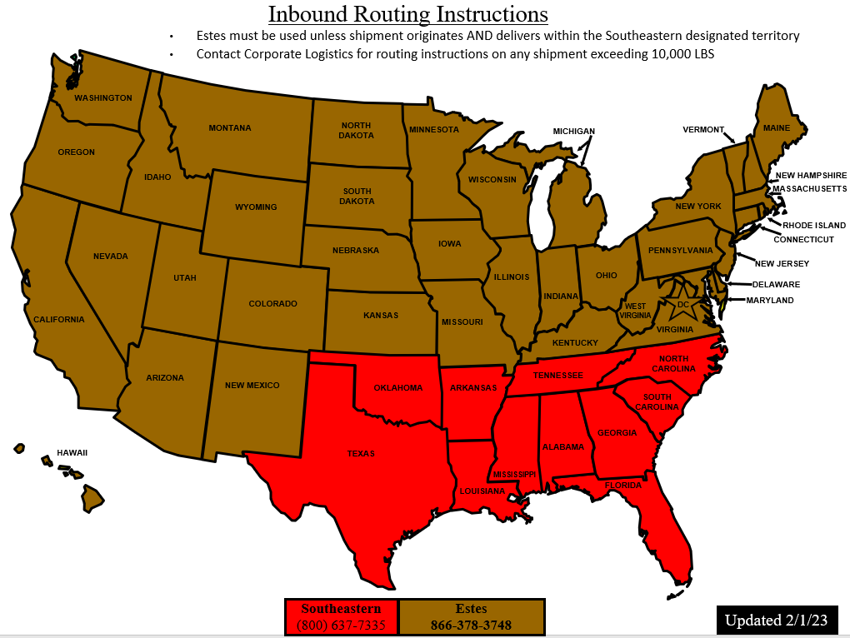
Milliken LTL Inbound Routing Guide
6
IMPORTANT!
Please route all LTL shipments based on the state in which the shipment originates
If shipping on the same day from same origin to same destination please refer to our consolidation rules on page 7
For all other inquiries regarding routing or consolidation instructions please call Corporate Logistics at 864-503-1789

Slide 7
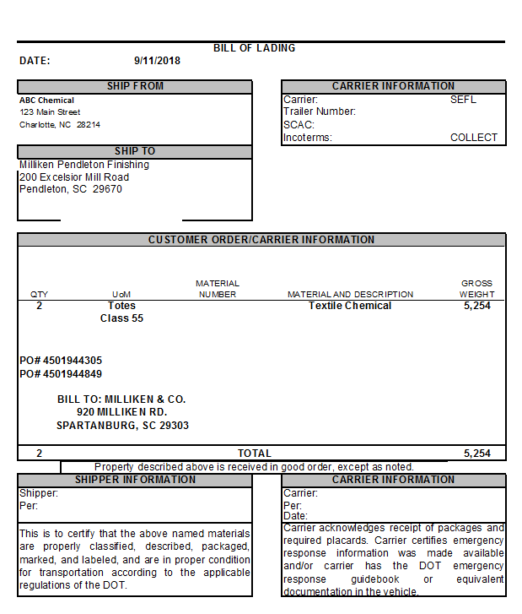
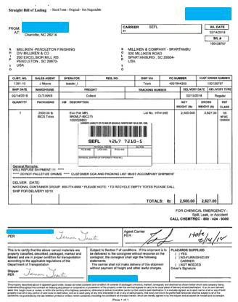
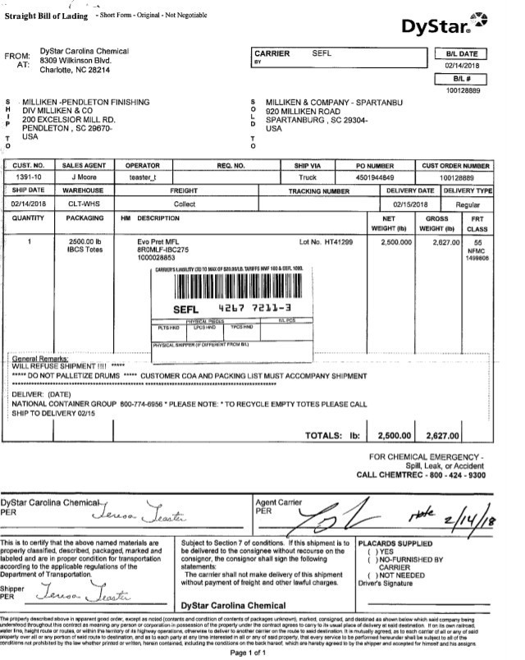
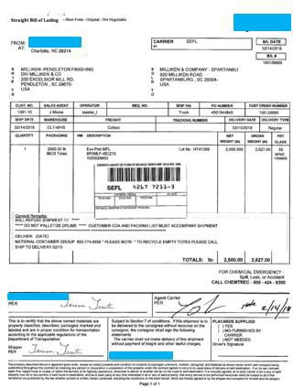
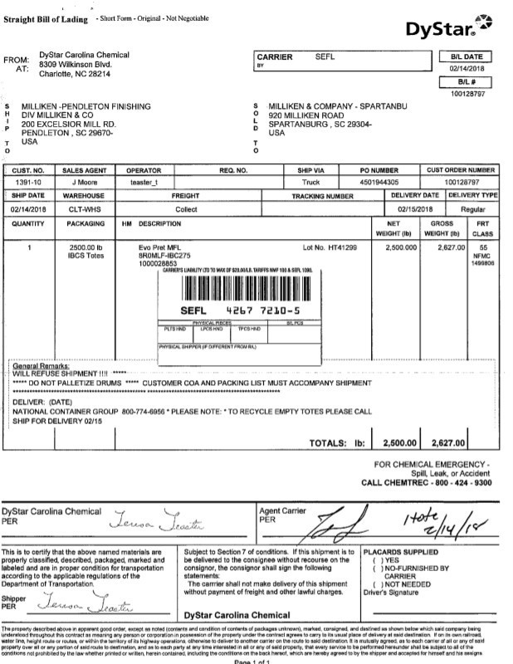
LTL Bill of Lading Consolidation Instructions
7
Multiple LTL bills of lading (BL) shipping on the same day to the same destination should be CONSOLIDATED under a single MASTER BL showing each PO#, total weight & total piece count.
Two (2) Shipments on Same Day - INCORRECT
Two (2) Shipments on Same Day - CORRECT
1
2
3
PO# 4501944305
PO# 4501944849
1
2
2 separate shipments presented to carrier @ 2,627LB each
1 consolidated shipment presented tocarrier @ 5,254LB
©2010 Milliken, Private &Confidential

